Slide 1
EDUVISION ANALYTICS
Higher Education Performance Dashboard
Transforming University Ranking Data into Interactive Insights

Slide 2
Project Introduction
Complex Data
Dual Sources
University ranking datasets contain many performance indicators that are difficult to interpret manually
The project combines both QS and THE ranking datasets into a unified analytical framework
Visual Insights
Comparison
Tableau converts complex data into interactive visual insights for easy exploration
Enables meaningful comparison of universities and countries across multiple indicators

Slide 3
Problem & Objective
Problem
Objective
Large and complex ranking datasets
Difficult manual comparison
Multiple indicators across datasets
Difficult to identify patterns quickly
Analyze university performance
Compare universities and countries
Understand research and student metrics
Create interactive visual insights

Slide 4

Data Processing Workflow
Missing Values
Numeric Convert
Collection
Integration
Cleaning
Raw ranking data from QS and THE sources is systematically processed through eight stages before being visualized in Tableau interactive dashboards.

Slide 5
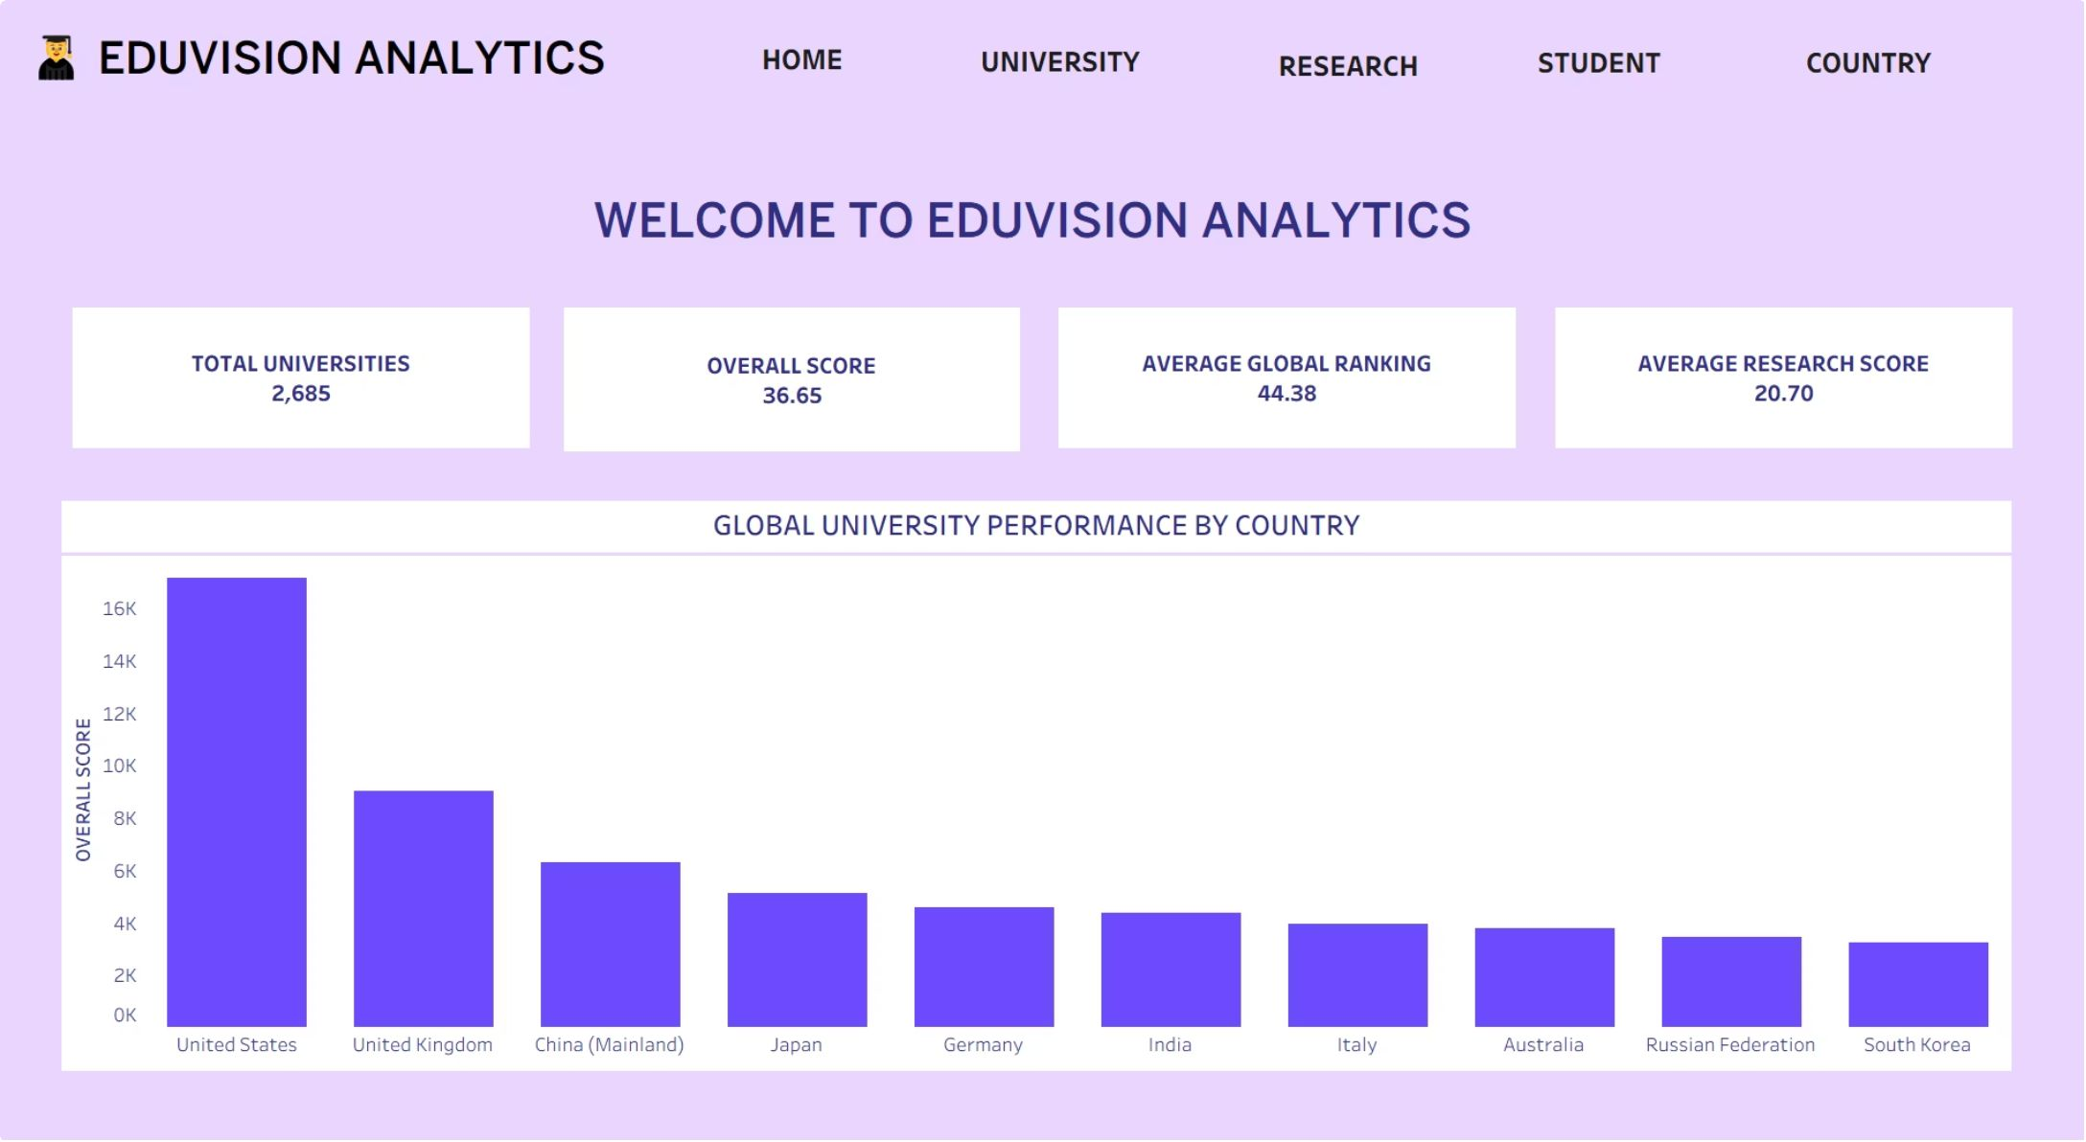
Home Dashboard
Provides an overall view of university performance using key ranking indicators. It summarizes total universities, overall score, global ranking and country-level performance.
Overall performance summary
Key ranking indicators
Country-level comparison
Main navigation dashboard

Slide 6
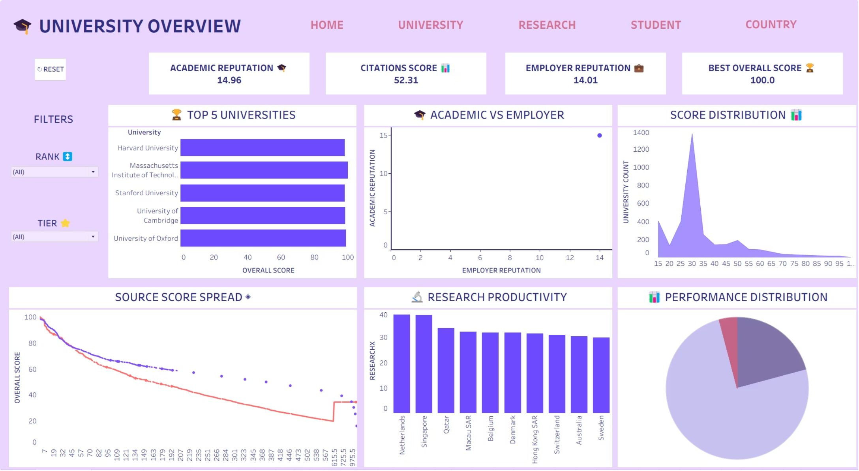
University Analytics
Focuses on university-level performance and comparison using academic, citation, employer and overall performance indicators.
Top university comparison
Academic reputation
Citation performance
Employer reputation
Performance tiers

Slide 7
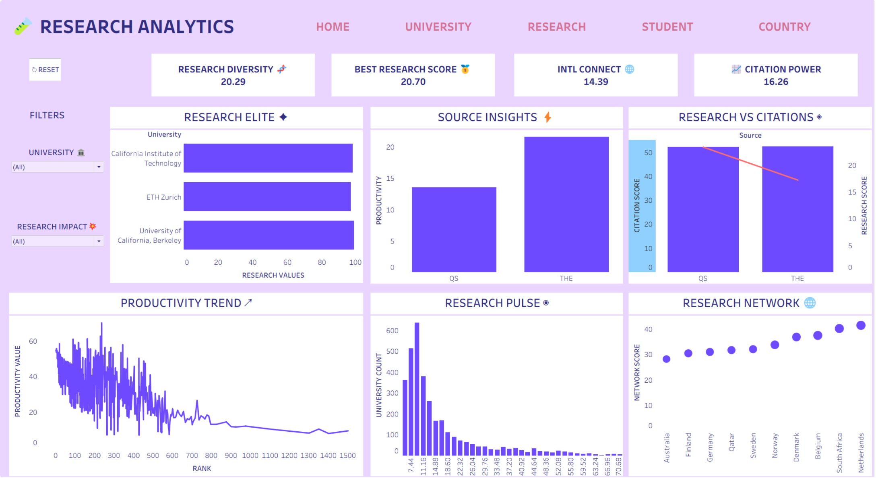
Research Analytics
Analyzes research strength and research-related indicators across universities and countries.
Research performance
Research leaders
Citation analysis
Research productivity
International research network

Slide 8
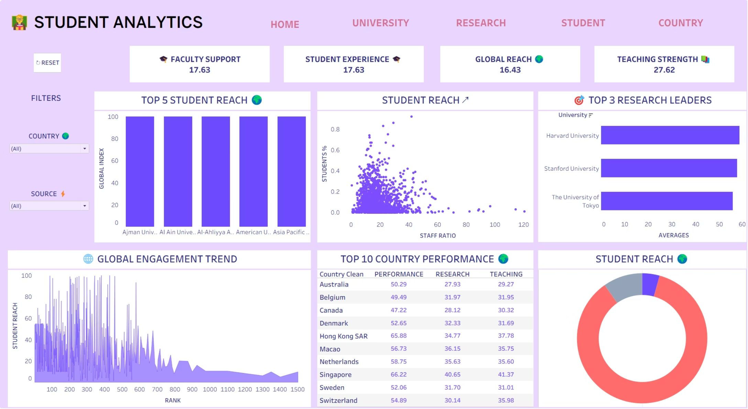
Student Analytics
Analyzes student-focused indicators such as student experience, teaching strength and international student reach.
Student experience
Teaching strength
Global reach
Student reach analysis
International student indicators

Slide 9
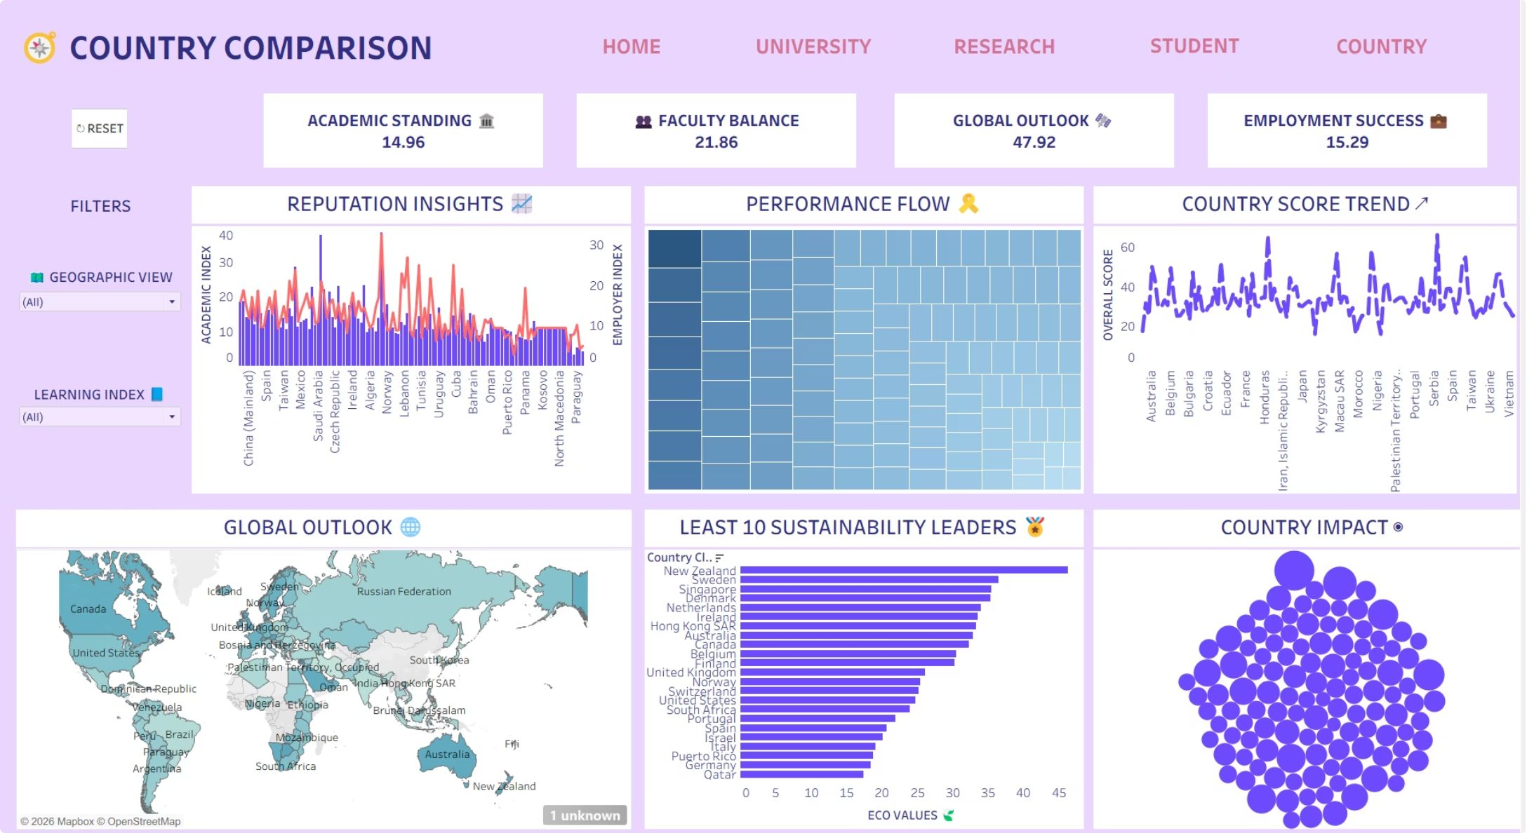
Country Comparison
Compares higher-education performance across countries using academic, faculty, global outlook, employment and sustainability indicators.
Academic standing
Faculty balance
Global outlook
Employment success
Sustainability comparison

Slide 10
Thank You
Questions & Answers

